Slide 1



PRESENTED BY:
REYHANEH SARBAZIHA
Solicitor
&
DANIELLA DE VONTE
Solicitor
Notes:
1

Slide 2
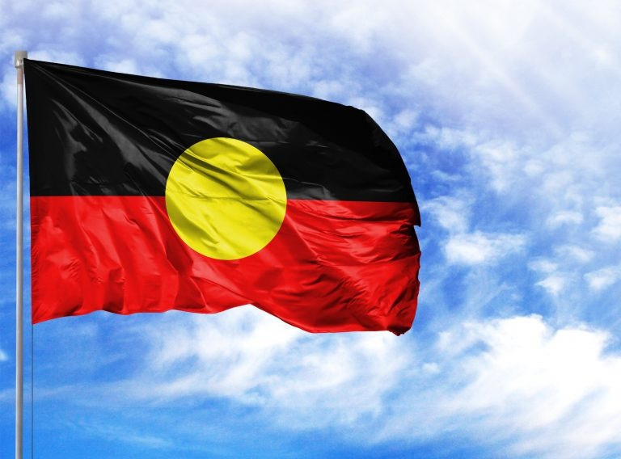
ACKNOWLEDGEMENT
We would like to acknowledge this land that we meet on today is the traditional lands for the Kaurna people and that we respect their spiritual relationship with their country.
We also acknowledge the Kaurna people as the custodians of the Adelaide region and that their cultural and heritage beliefs are still as important to the living Kaurna people today.
Notes:
2

Slide 3
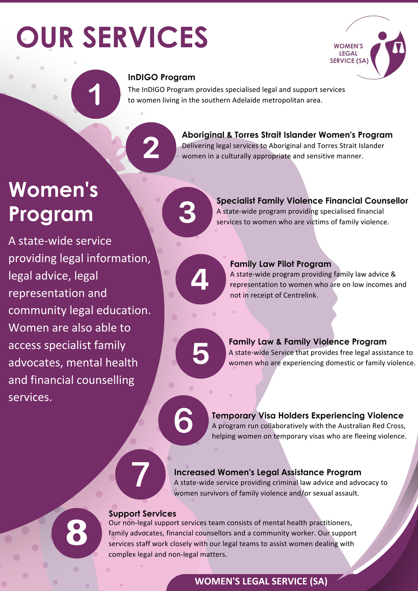
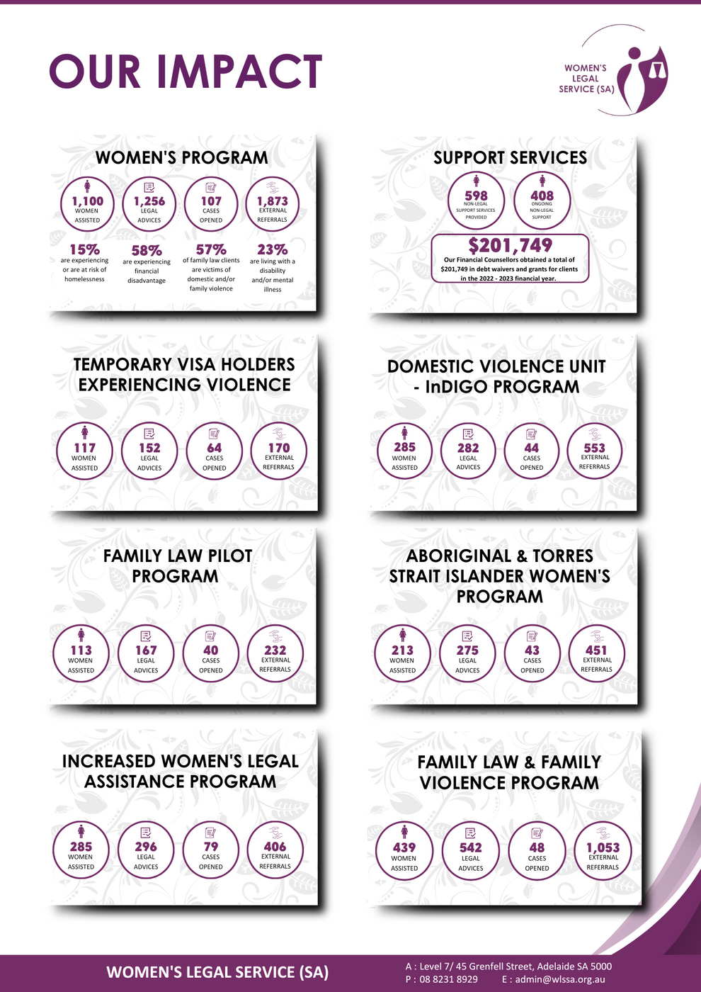
Notes:
3

Slide 4

WOMEN’S LEGAL SERVICE (SA)
Violence against women and children is a problem of epidemic proportions in Australia.
On average, a woman is killed by an intimate partner every 10 days.
A woman is also more likely to experience violence at particular life stages, such as while separating from a relationship.
One in three women has experienced physical violence since the age of 15, and one in five has experienced sexual violence.
*National Plan to End Violence against Women and Children 2022-2032

Slide 5

WOMEN’S LEGAL SERVICE (SA)
Sexual Assault Statistics
A high proportion of women in Australia (one in five) have experienced sexual violence since the age of 15, and one in sixteen men have experienced sexual violence since the age of 15.
Around one in five women and one in nine men have experienced physical or sexual violence before the age of 15.
A high proportion of sexual offences against children or young people were perpetrated by a family member, a friend, in an institutional context, or by someone known to the victim survivor.
In the family context, sexual violence often occurs alongside other forms of physical violence carried out by a partner, spouse, or parent.
Only about 13% of sexual offences are reported to police. Victim survivors (particularly child victim survivors) often report it many years later.
Women with a disability and Aboriginal or Torres Strait Islander women are more likely to have experienced sexual violence than other women.
Australian Law Reform Commission, Justice Responses to Sexual Violence: Issues Paper (2024)
Notes:
6

Slide 6
WOMEN’S LEGAL SERVICE (SA)
Sexual Assault Statistics
Sexual assault continues to be underreported to police in Australia.
Prosecution rates are low and conviction rates are even lower.
This illustrates the barriers faced by victim-survivors.
MAG Work Plan on Criminal Justice Responses to Sexual Assault 2022-2027

Slide 7
WOMEN’S LEGAL SERVICE (SA)
Sexual Assault Statistics - South Australia
In the most recent Australian Bureau of Statistics (ABS) publication Recorded Crime – Victims, the number of victims of sexual assault recorded by police in SA increased by 2% from 1,783 in the previous year to 1,816 victims in 2022.
The number of sexual assault victims increased by 33 victims and was the highest recorded figure in the past 19 years.
The sexual assault victimisation rate for Aboriginal persons was twice the overall rate.
Most sexual assault victimisation occurred in a residential setting and did not involve a weapon.
Attorney-General’s Department - Review of sexual consent laws in South Australia - Discussion paper (2022)
Notes:
10

Slide 8
WOMEN’S LEGAL SERVICE (SA)
Sexual Assault Statistics - South Australia
Across all age ranges, the majority of sexual assault victims were female with 35% of these aged between 0 and 17 years.
The majority of both female and male victims of sexual assault knew the offender.
Despite the increase in numbers, sexual violence is still under-reported to police.
According to the 2021-22 ABS Personal Safety Survey, Australia-wide figures show the majority (92% or 680,300) of women who experienced sexual assault by a male did not report the most recent incident to police.
The most common reasons women did not report the incident included:
    not regarding the incident as a serious offence
    feelings of shame or embarrassment
    thinking that there was nothing the police could do.
Attorney-General’s Department - Review of sexual consent laws in South Australia - Discussion paper (2022)
Notes:
10

Slide 9

WOMEN’S LEGAL SERVICE (SA)
About our Family Violence & Sexual Assault Legal Service
The Family Violence & Sexual Assault Legal Service provides assistance to victim/survivors navigating the criminal justice system, Intervention Orders, dealing with police and IO breaches, VOCs, providing advice and advocacy to women who are victims in relation to criminal charges arising out a family violence or sexual assault.
We seek to understand trauma and its impact on those who come into contact with the criminal justice system, both as offenders and victims and survivors.

Slide 10


WOMEN’S LEGAL SERVICE (SA)
In collaboration with a SA Health Network rape and sexual assault service, we provide outreach twice a month, advising and informing sexual assault victim and survivors.
Notes:
9

Slide 11
WOMEN’S LEGAL SERVICE (SA)
Common myths and misconceptions
Misconceptions
  It is a misconception to believe that a complainant of sexual violence should be able to remember the experience in a clear, detailed, linear, and uninterrupted sequence without inconsistency or omission.
  Victim-survivors may recall aspects of the offending gradually over a period of time; it is a misconception to expect that recall should happen all at once at a police station.
  The ‘common sense’ belief that a complainant of sexual violence will report their experience immediately is a myth.
Australian Law Reform Commission, Justice Responses to Sexual Violence: Issues Paper (2024)
Notes:
REY

Slide 12

WOMEN’S LEGAL SERVICE (SA)
Common myths and misconceptions
The Victorian Jury Directions Act 2015, as amended by the Justice Legislation Amendment (Sexual Offences and Other Matters) Act 2022, includes the following directions about sexual offences that are not captured under section 34N of South Australia’s Evidence Act:
  A direction to address misconceptions about counterintuitive behaviours, such as maintaining a relationship or communication with the perpetrator after non-consensual activity.
Attorney-General’s Department - Review of sexual consent laws in South Australia - Discussion paper (2022)
Notes:
11

Slide 13
WOMEN’S LEGAL SERVICE (SA)
IDENTIFYING THE
PRIMARY AGGRESSOR/MISIDENTIFIED VICTIMS
FAMILY LAW ACT
Notes:
13

Slide 14

WOMEN’S LEGAL SERVICE (SA)
Intervention Orders
Many free legal service organisations (e.g. LSC, ALRM) do not offer assistance with Intervention Order defence. There is a barrier to justice especially when the Respondent/Defendant is not the primary aggressor.
Correctly identifying the primary aggressor is essential for ensuring the protection of survivors and holding perpetrators accountable for family violence.
Women’s Legal Service (SA) found that 76 per cent of their clients had been misidentified as respondents on police and private applications for intervention orders.
Notes:
14

Slide 15
WOMEN’S LEGAL SERVICE (SA)
Indicators for identifying the primary aggressor:
  The injuries of the parties
  Patterns of coercion, intimidation and/or violence by either party
  Prior perpetration/histories of violence (from a range of services, including specialist family violence services, health services etc)
  The size, weight and strength of the parties.
Monitoring Victoria’s family violence reforms Accurate identification of the predominant Aggressor, December 2021
Notes:
15

Slide 16
WOMEN’S LEGAL SERVICE (SA)
Other issues
Intervention Order & Family Court Orders
Generally, parties will find obtaining an Intervention Order in the Magistrates Court a more effective option for the protection of themselves and their children from Family Violence.
The biggest issue is the delay and response, police cannot enforce family law orders, but police can enforce Intervention Orders.
Clients must apply to the FCFCOA (Contravention Applications), which creates a delay.
Where an intervention differs from FCFCOA Orders, the FCFCOA Orders will override the Intervention Order. The Intervention Order will remain active, except for the inconsistency, Family Law Act ([16]).
Notes:
16

Slide 17
WOMEN’S LEGAL SERVICE (SA)
.
Adding children to the Intervention Order
Many Magistrates or SAPOL are reluctant to include children unless they direct victims of physical violence.
T, R v L, KC [2013] SASC 51
If the FCFCOA has made parenting orders addressing the risk to the safety of children, then the children should not be included on a Final Intervention Order.
Notes:
16

Slide 18
WOMEN’S LEGAL SERVICE (SA)
Important questions to ensure all-round advice is given
  Are there any children?
  Are there any Parenting Orders/Agreements or current proceedings?
  Is the Interim Intervention Order going to interfere with parenting arrangements?
  Is the client an Australian citizen or permanent resident?
  Does the client somewhere safe to go? (e.g. if the Intervention Order is not granted, or granted and it does not remove them from the house)
  Has there been any contact by or with the Department for Child Protection?
  Has the client made any reports to the doctors, police or child(ren)’s school?
Notes:
17

Slide 19
WOMEN’S LEGAL SERVICE (SA)
Important questions to ensure all-round advice is given
  When was the last time the alleged preparator contacted you?
  Do you have screenshots, voicemails, emails or other evidence to support your claims?
  Has there been a conviction?
Notes:
17

Slide 20
WOMEN’S LEGAL SERVICE (SA)
HOW CAN PROFESSIONALS REFER IN?
Phone: 08 8231 8929 – press 4
Email: referral@wlssa.org.au

Slide 21
QUESTIONS?
T:
E:
W:
08 8231 8929
admin@wlssa.org.au
wlssa.org.au
Notes:
18

