Slide 1


BEYOND THE CASE:
VICARIOUS TRAUMA AWARENESS AND PREVENTION
FACILITATED BY
ANISA VARASTEH

Slide 2


OVERVIEW
  Definition and Overview
  Impact on Lawyers
  Why Does Vicarious Trauma Happen?
  Self Assessment
  Preventing Vicarious trauma
  Creating a Personal Self-Care Plan
WWW.RELATEINSTITUTE.COM.AU

Slide 3

VICARIOUS TRAUMA
Definition:
Vicarious trauma is experiencing the symptoms of PTSD due to exposure to the trauma of others over time.
Exposure to Traumatic Content:
Lawyers, especially those working in criminal law, family law, immigration law, and human rights law, frequently encounter graphic details of violence, abuse, and other traumatic events through their clients’ cases.
High-Stakes Environments:
The high-stakes nature of legal cases, where outcomes can dramatically affect clients’ lives, adds additional stress.
WWW.RELATEINSTITUTE.COM.AU

Slide 4
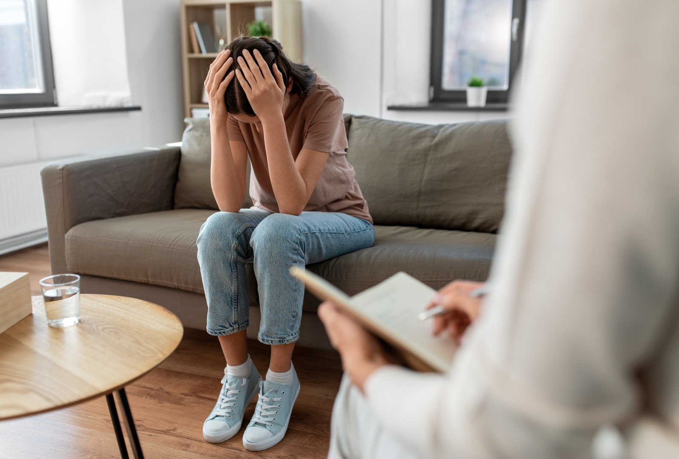
ONLY ONE VARIABLE RELIABLY PREDICTS THE RISK OF VT: REPEATED EXPOSURE TO TRAUMATIC MATERIAL
Repeated exposure can intensify the body’s natural response and impact on how we think about ourselves, our relationships, others and the world.
Notes:
The trauma literature suggests only one variable reliably predicts the risk of VT: repeated exposure to traumatic material. Repeated exposure can intensify the body’s natural response and subsequently impact on how we think about ourselves, our relationships, others and the world.
The negative impact of secondary trauma exposure can resolve without lasting negative effects particularly if you recognise it and attend attend to it by utilising effective self-care strategies and accessing support.

Slide 5

IMPACT OF VICARIOUS TRAUMA
Behavioural Impact
  Reluctance to engage with certain cases.
  Avoiding reading case files.
  Hesitation to make or return phone calls.
  Withdrawal from social interactions.
  Decreased productivity.
  Increased absenteeism.
  Over-involvement in work.
WWW.RELATEINSTITUTE.COM.AU

Slide 6

IMPACT OF VICARIOUS TRAUMA
Intrusion
  Experiencing dreams or nightmares related to cases.
  Persistent, intrusive thoughts about clients' traumas.
  Discussing case details with friends and family instead of focusing on personal interests or hobbies.
WWW.RELATEINSTITUTE.COM.AU

Slide 7
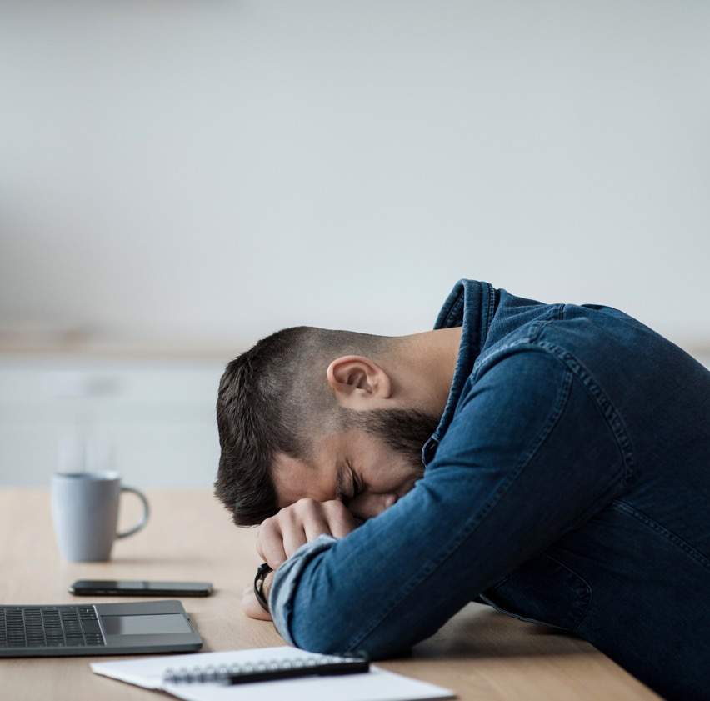
IMPACT OF VICARIOUS TRAUMA
Loss of Joy
  Decreased enjoyment in favourite hobbies or activities.
  Trouble sleeping, whether difficulty falling asleep or sleeping more than usual.
  Increased irritability or emotional sensitivity.
WWW.RELATEINSTITUTE.COM.AU

Slide 8
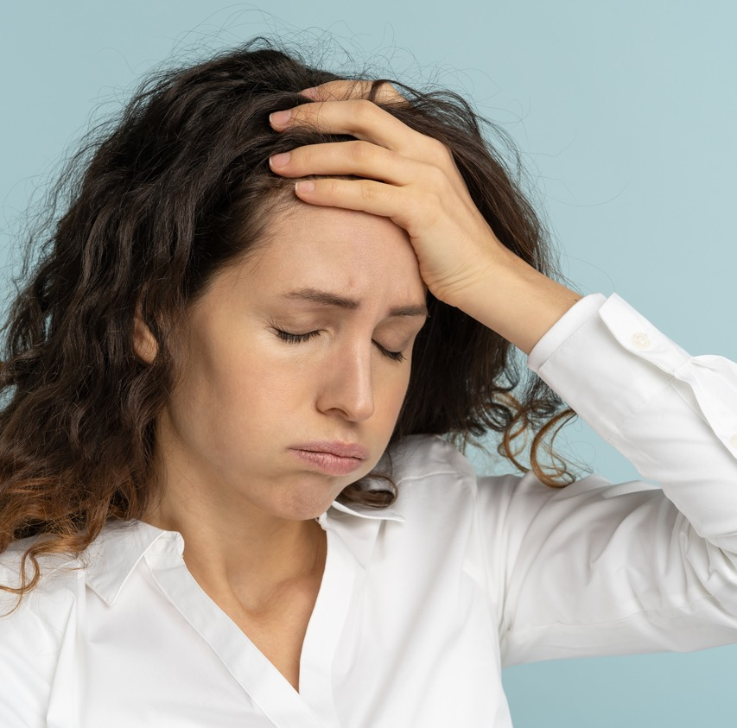
IMPACT OF VICARIOUS TRAUMA
Cognitive Impact
  Changes in worldview, such as increased cynicism.
  Difficulty trusting others.
  Negative shifts in beliefs and attitudes about oneself, others, and the world (e.g., feeling that the world is unsafe).
WWW.RELATEINSTITUTE.COM.AU

Slide 9
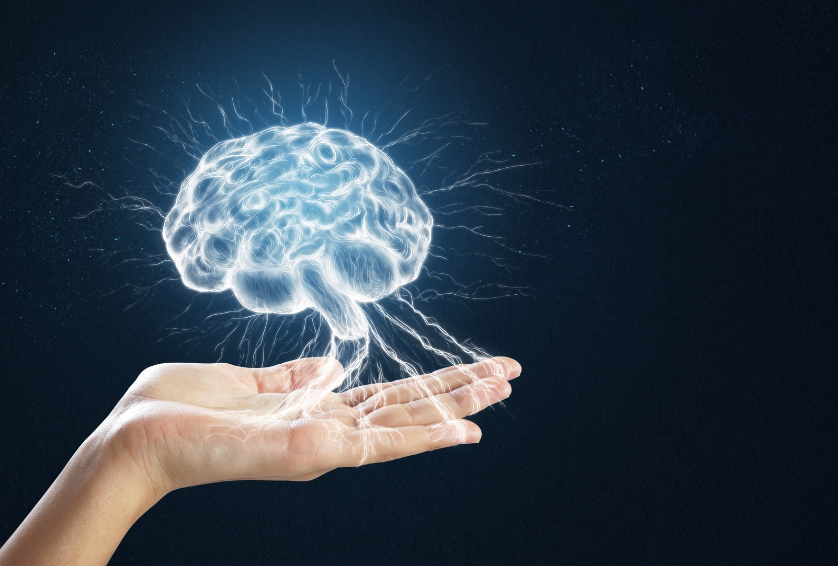
WHY DOES VICARIOUS TRAUMA HAPPEN?
Resonance:
the brain's ability to empathise and connect with others through mirror neurons, which enable individuals to mimic and internalise the movements and facial expressions of those they observe.

Slide 10
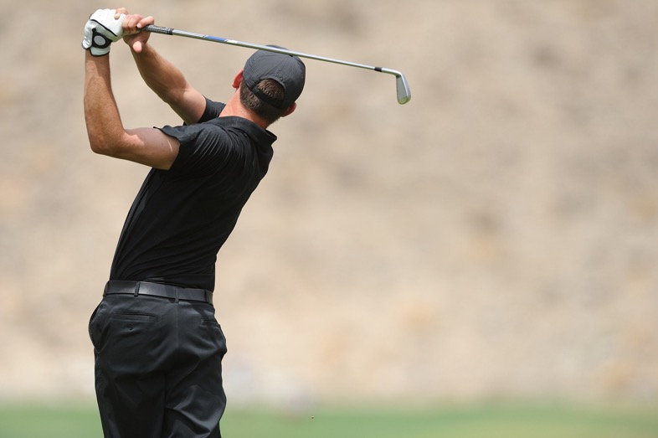

Notes:
your brain fired as though you are swinging a golf club. You just need to be familiar with the movement. They’ve shown ballerina’s picture of people doing martial arts and their brain fired as though they had engaged in the same movement. How does this relate to vicarious trauma:

Slide 11

Notes:
Facial Expression of tone of voice are 2 things that are brain mirrors. So if you see pictures like these: (happy children) your brain fires neurons as if you are smiling and if you see pictures like this (sad children) same thing. So if your brain is exposed to such content over and over again it reacts as if it has been exposed to the same distress.
But trauma doesn’t just affect the brain and mind. It also affects the body.

Slide 12
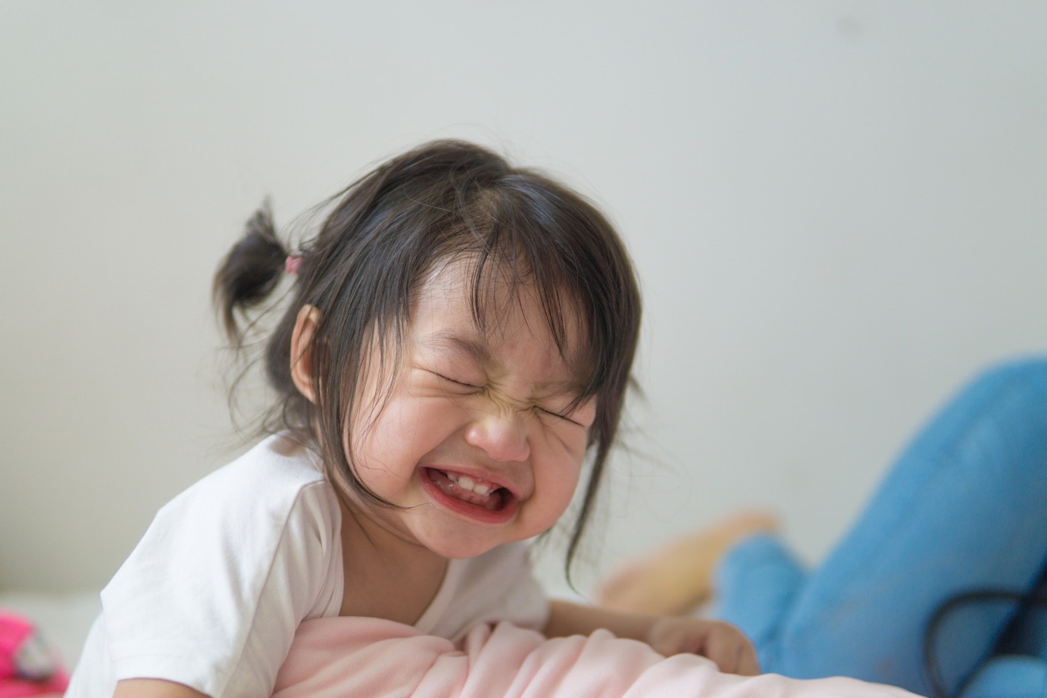

Slide 13
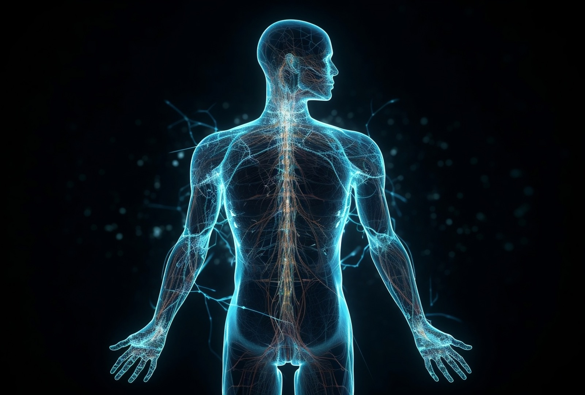
HOW TRAUMA AFFECTS THE BODY
WWW.RELATEINSTITUTE.COM.AU

Slide 14
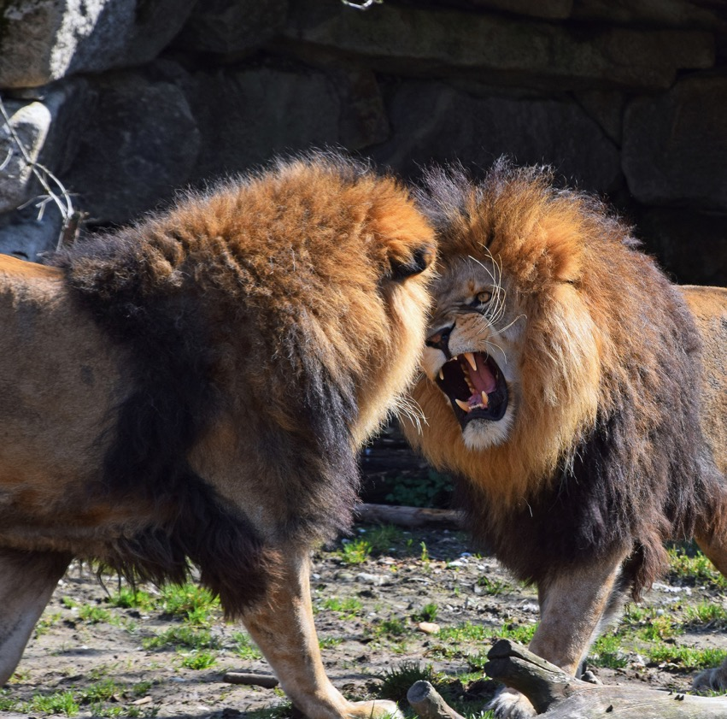
HOW THE BODY RESPONDS TO TRAUMA
When faced with a traumatic event, the body’s autonomic nervous system (ANS) activates the fight, flight, or freeze response.
  Fight Response: Prepares the body to confront the threat (e.g., increased heart rate, muscle tension).
  Flight Response: Prepares the body to escape the threat (e.g., adrenaline surge, rapid breathing).
  Freeze Response: Immobilises the body when neither fight nor flight seems possible (e.g., dissociation, feeling numb).
WWW.RELATEINSTITUTE.COM.AU

Slide 15
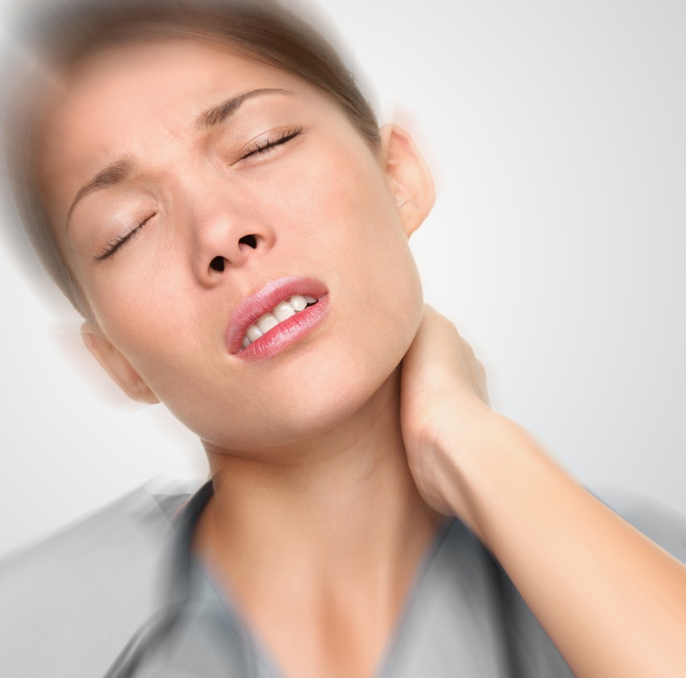
SOMATIC SYMPTOMS OF VICARIOUS TRAUMA:
Chronic Pain:
Persistent pain in the muscles, joints, or headaches can result from prolonged stress and tension.
Fatigue:
Continuous emotional stress can lead to extreme tiredness and a lack of energy.
Tension:
Muscle tightness, particularly in the neck, shoulders, and back, is a frequent response to ongoing stress.
WWW.RELATEINSTITUTE.COM.AU
Notes:
(10 minutes)
Body Sensations
These physical sensations may indicate underlying stress, anxiety, or emotional strain. Notice where you feel sensations in your body and what emotions may be associated with them.
Physical Symptoms
These symptoms may be indicative of underlying psychological hazards. Listen to your body's messages and seek support to address any physical symptoms you experience.

Slide 16

TRACKING THE BODY
WWW.RELATEINSTITUTE.COM.AU

Slide 17

ACTIVITY
Reflect on a Challenging Client
WWW.RELATEINSTITUTE.COM.AU
Notes:
(10 minutes)
Experiential exercise
Take a few moments to think about a client you find challenging or difficult to work with. Consider a recent interaction or a recurring situation that evokes small amount of discomfort or frustration.
Close your eyes if comfortable and tune into your body. Notice any sensations that arise as you think about this client. Pay attention to areas of tension, tightness, discomfort, or other physical sensations you may experience.
Take note of these bodily sensations without judgment, allowing yourself to fully acknowledge and experience them in the present moment.

Slide 18

ACTIVITY
Reflect on a Favourite Client
WWW.RELATEINSTITUTE.COM.AU
Notes:
Now, shift your focus to a client you enjoy working with or have a positive relationship with. Visualise a recent interaction or recall a specific moment that brings joy or satisfaction.
Once again, close your eyes if comfortable and tune into your body. Notice any sensations that arise as you think about this client. Pay attention to areas of relaxation, ease, warmth, or other physical sensations you may experience.
Take note of these bodily sensations, allowing yourself to fully immerse in the feelings of connection and positivity associated with this client.

Slide 19

REFLECTIVE ACTIVITY
Self-care questionnaire
WWW.RELATEINSTITUTE.COM.AU
Notes:
(5 minutes)
Distribute the self-care questionnaire to participants.
Explain that the questionnaire will help gauge participants' current level of self-care practices and attitudes towards well-being. This is for reflection purposes only.
Instruct participants to take a few minutes to complete the questionnaire individually.

Slide 20

MINIMISING THE RISK OF VICARIOUS TRAUMA
Somatic Psychotherapy
  Looking out the window into the distance (broadening the vision).
  Wriggling your toes.
  Becoming aware of your spine or the back of your neck.
  Using your five senses to ground yourself in the present moment.
WWW.RELATEINSTITUTE.COM.AU
Notes:
Somatic psychotherapy looks at the connection of the mind and body
impact one, it may impact the other

Slide 21

MINIMISING THE RISK OF VICARIOUS TRAUMA
Cognitive Behaviour Therapy (CBT)
  Tell yourself: “ I am hearing a story and it is not happening to me.” And “I am aware I am having an emotional reaction.”
  Visualisation: Imagine the story your client is sharing landing in the space between you and them, rather than on or in you.
  Exposing yourself to happy stories, people, places proactively!
WWW.RELATEINSTITUTE.COM.AU
Notes:
ACT
Defusion - I am having the thought that

Slide 22

MINIMISING THE RISK OF VICARIOUS TRAUMA
Behavioural & Lifestyle:
  Debriefing, Supervision, Therapy
  Setting Boundaries
  Engaging in Hobbies and Leisure Activities
  Regular Physical Exercise
WWW.RELATEINSTITUTE.COM.AU

Slide 23
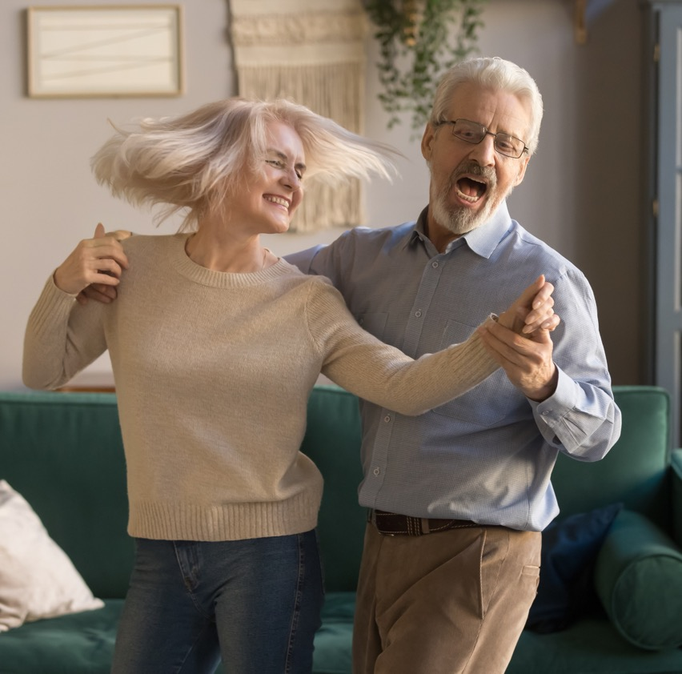
MINIMISING THE RISK OF VICARIOUS TRAUMA
Social and Environmental Approaches:
  Connecting with loved ones
  Building a Supportive Network
WWW.RELATEINSTITUTE.COM.AU

Slide 24

TRACKING THE BODY
Experiential learning
WWW.RELATEINSTITUTE.COM.AU

Slide 25

TRACKING THE BODY
Experiential learning
WWW.RELATEINSTITUTE.COM.AU
Notes:
https://www.youtube.com/watch?v=8myYyMg1fFE

Slide 26

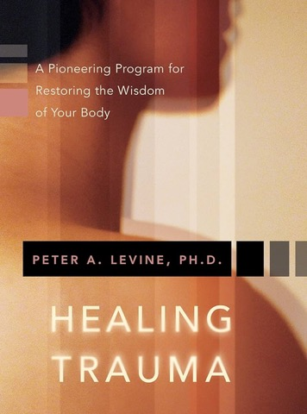

REFERENCES AND FURTHER READING
Healing Trauma
by Peter Levine
The Happiness Trap
by Russ Harris
WWW.RELATEINSTITUTE.COM.AU

Slide 27

GROUP DISCUSSION
WWW.RELATEINSTITUTE.COM.AU

Slide 28

REFLECTIVE ACTIVITY
Personal Plan
WWW.RELATEINSTITUTE.COM.AU
Notes:
(10 minutes)
Provide participants with the Personal Plan worksheet to guide their individual reflection and planning process.
Instruct participants to take the next 10 minutes to reflect on the information learned in the session and create their personalised risk management plan.
Encourage participants to consider their own roles, responsibilities, and specific challenges they may face in their caregiving roles.
Prompt participants to identify specific strategies and actions they can take to mitigate the risk of psychological harm.

Slide 29
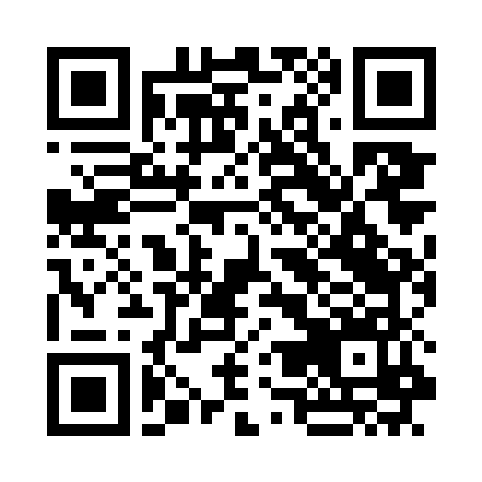
WWW.RELATEINSTITUTE.COM.AU
Notes:
please if you could fill in the feedback form

Slide 30
GET IN TOUCH!
CONTACT INFORMATION
Website
www.relateinstitute.com.au
Contact
anisa@relateinstitute.com.au

